Slide 1
QUEUE MANAGEMENT SYSTEM
ANTO JOSEPH
ROLL NO:22
MCA-A

Slide 2
CONTENT
ABSTRACT
MODULES
DIAGRAMS
TABLE-DESIGN
SCREENSHOT

Slide 3
“Queue management” is based on the innovation in medical field that there is no application for users to explore the services offered by the hospital management. Even though, there is website and application exist for particular hospitals, there is no application that contain the whole hospitals details. That is all hospitals and their features are come under one category.
One of the main feature of the system is live token number system. So that the patients can see whether their token number called or not. With this functionality the patients not need to be actively present on the front door of doctors. This feature can see only by that members who make appointments with the doctor.

Slide 4
PROJECT SPECIFICATION
Users can see the present doctors on a day
Fix appointment with doctors
Scheduled time
live token number system in all department of hospital

Slide 5
Administrator Module
Create database of hospital
Adding, deleting, doctors
Adding pharmacy and laboratory department

Slide 6
Doctors Module
Call patients
Adding patients to waiting list
Allocate patients to pharmacy
User/Patients Module
User registration
Take Appointment with doctor
view live token number and their own token number
Recover OP number

Slide 7
Pharmacy Module
Call the patients
Add patients to waiting list
Laboratory Module
Call the patients for collecting blood sample and for result
Add patients to waiting list

Slide 8
DIAGRAMS

Slide 9
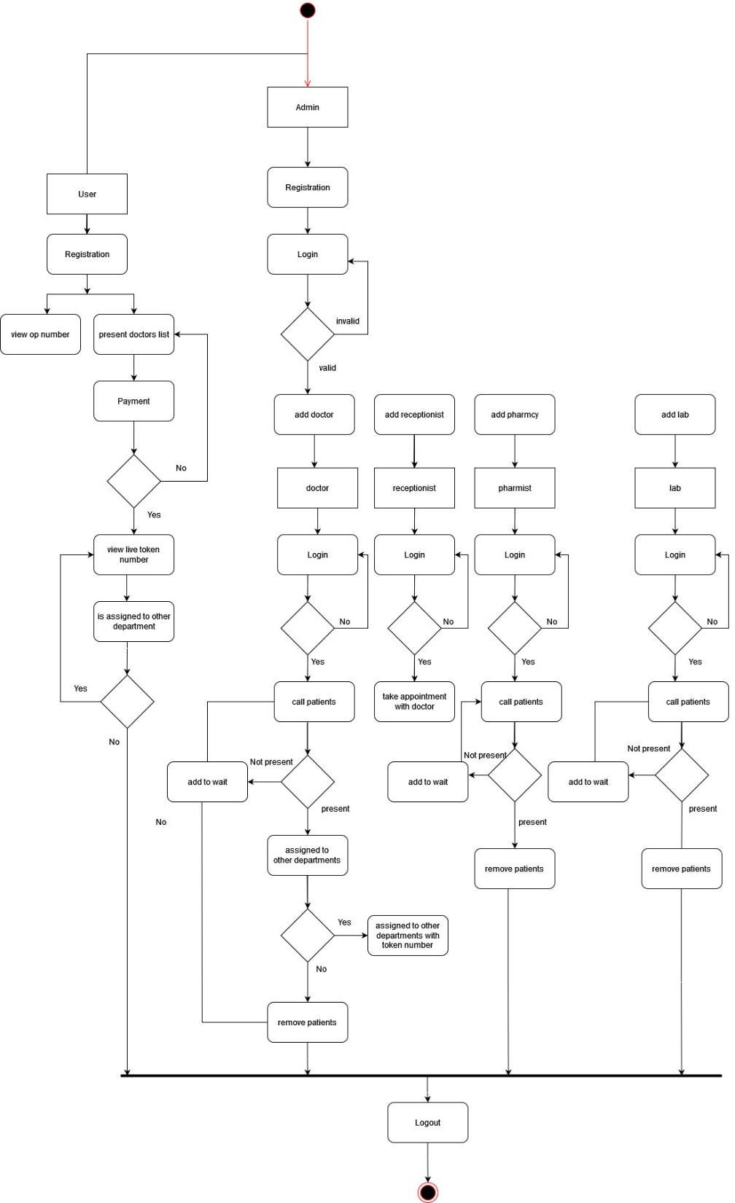
ACTIVITY DIAGRAMS

Slide 10
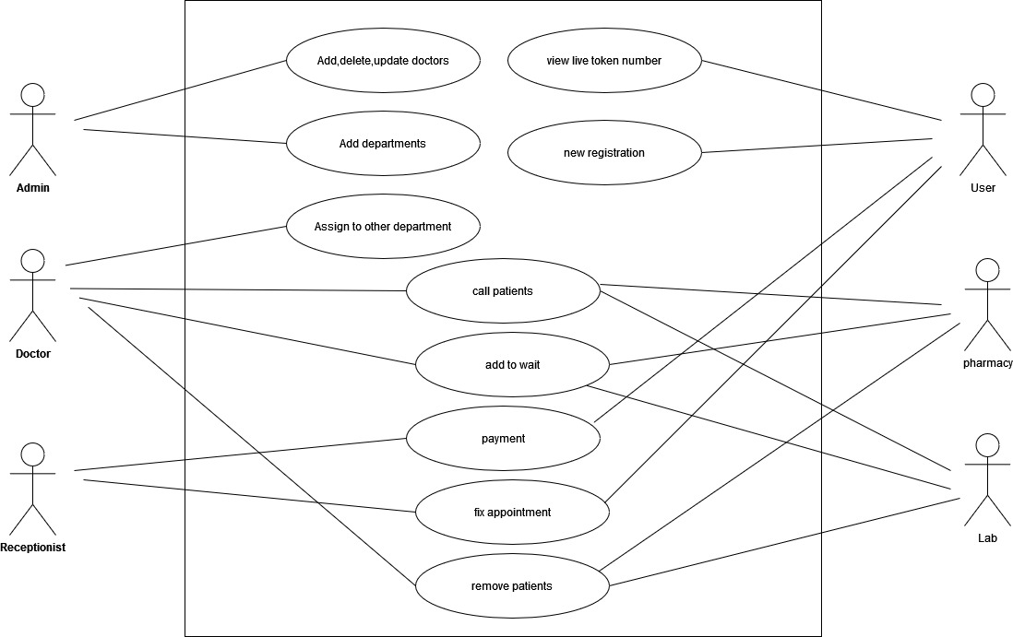
USECASE DIAGRAM

Slide 11
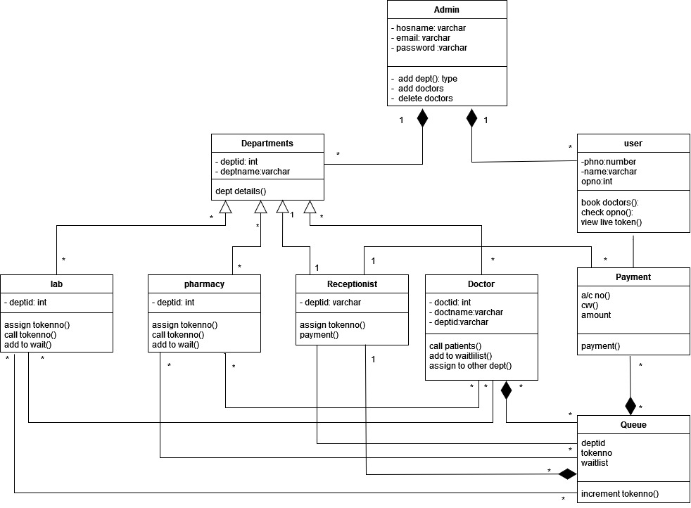
CLASS DIAGRAM

Slide 12
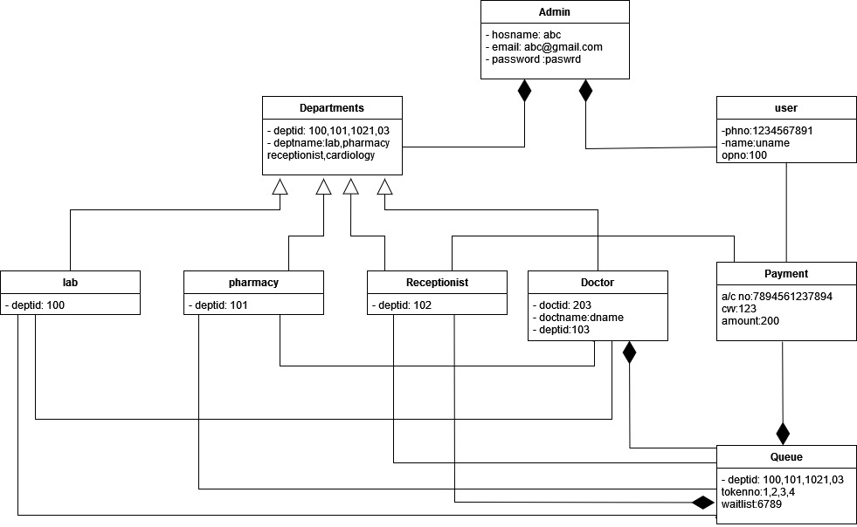
OBJECT DIAGRAM

Slide 13
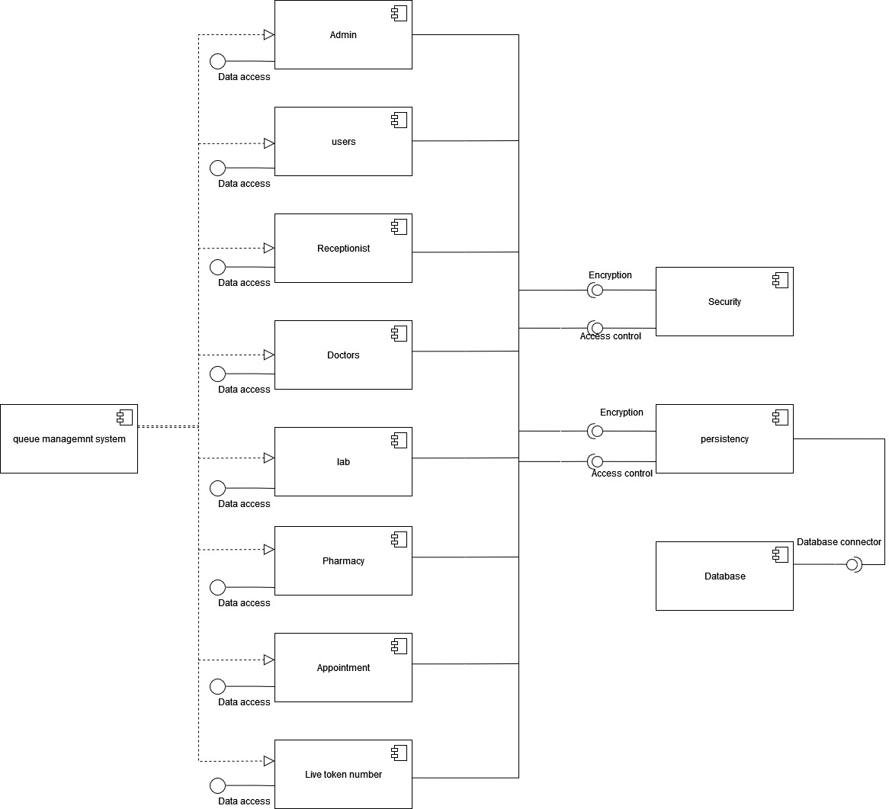
COMPONENT DIAGRAM

Slide 14
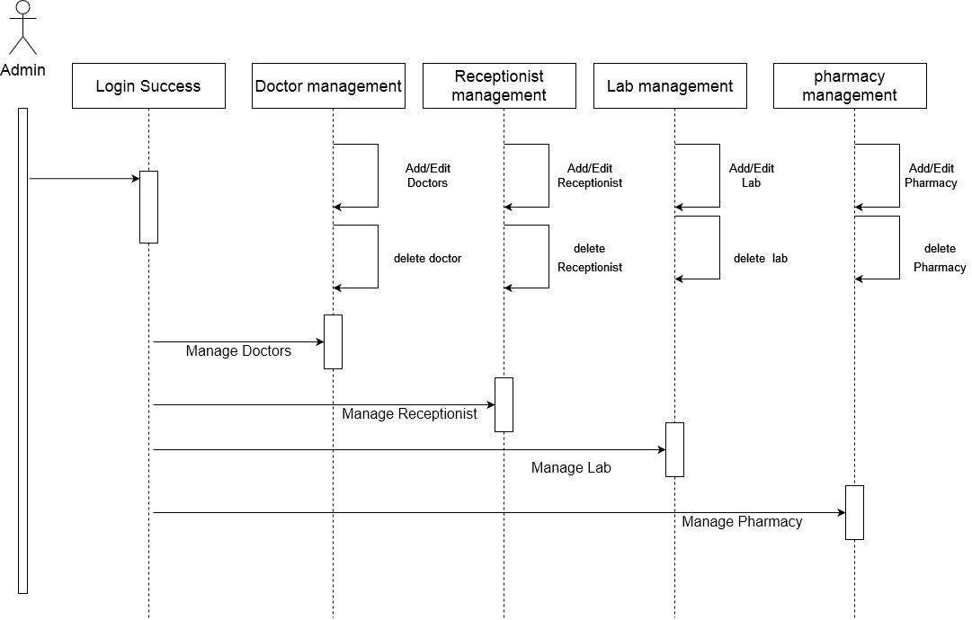
ADMIN-SEQUENCE DIAGRAM

Slide 15
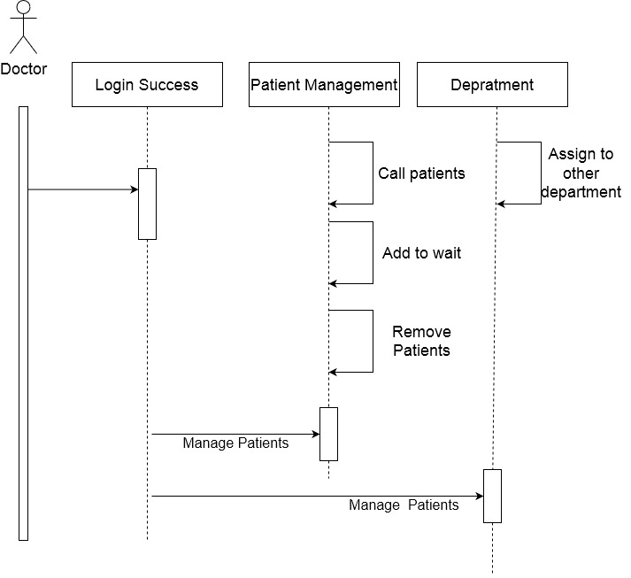
DOCTOR-SEQUENCE DIAGRAM

Slide 16
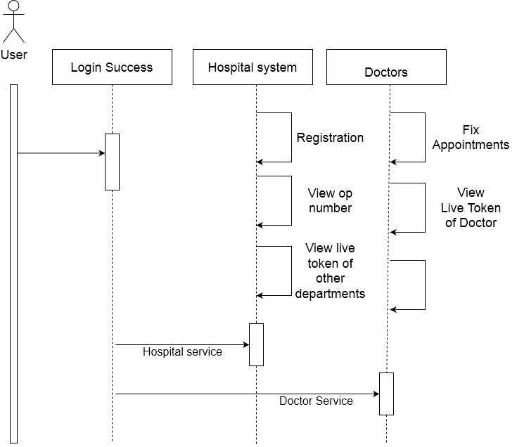
USER-SEQUENCE DIAGRAM

Slide 17
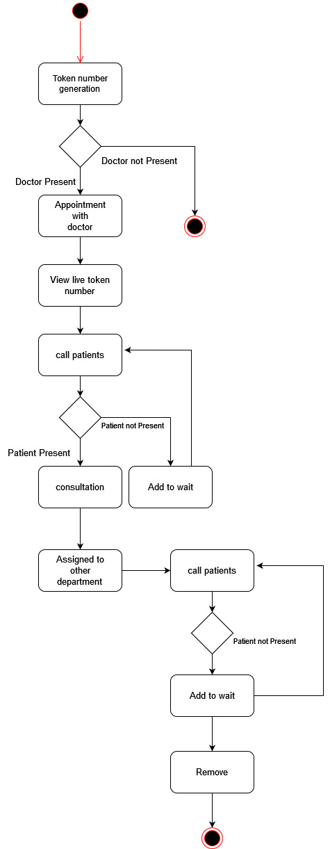
STATE-SEQUENCE DIAGRAM

Slide 18
TABLE-DESIGNS

Slide 19
hospital_database
Column | Datatype | Key | Description
hos_id | Int(10) | Primary Key | hospital id for the hospital
hosname | Varchar(50) | Not null | Hospital name
hosdb | Varchar(50) | Not null | Database name
state | Varchar(50) | Not null | state
district | varchar(10) | Not null | District

Slide 20
deptdoctors
Column | Datatype | Key | Description
dept_id | Int(20) | Foreign Key | Department id
doctname | varchar(20) | Not null | Doctor name
doctid | int(50) | Primary Key | Doctors id
password | varchar(50) | Not null | password
attendence | Varchar(50) | Not null | attendence
user | int(50) | Not null | Type of user

Slide 21
doctpatients
Column | Datatype | Key | Description
doct_id | Int(20) | Foreign Key | Doctor id
Opno | Int(20) | Not null | Op number
Tokenno | int(20) | Not null | Token number
waitlist | Float(50) | Not null | Wailtng list

Slide 22
hosdept
column | Datatype | key | descriptions
hos_id | Int(20) | Foreign key | Hospital id
Dept | Varchar(50) | Not null | Department name
deptid | Int(10) | Primary key | Department id

Slide 23
hosusers
column | Datatype | key | descriptions
hosid | Int(20) | Foreign key | Hospital id
Fname | varchar(20) | Not Null | First name of user
Lname | varchar(20) | Not Null | Last name of user
phno | bigInt(10) | Not Null | Phone number
opno | Int(10) | Not Null | Op number

Slide 24
pharpatients
column | Datatype | key | descriptions
phid | Int(20) | Foreign key | Pharmacy id
Opno | Int(20) | Not null | Op number
Tokenno | Int(20) | Primary key | Token number
Waitlist | int | Not null | Waiting list

Slide 25
pharpatients
column | Datatype | key | descriptions
phid | Int(20) | Foreign key | Pharmacy id
Opno | Int(20) | Not null | Op number
Tokenno | Int(20) | Primary key | Token number
Waitlist | int | Not null | Waiting list

Slide 26
SCREENSHOTES

Slide 27
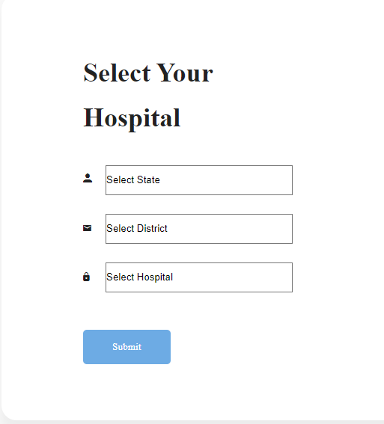
USERS – LOGIN PAGE

Slide 28
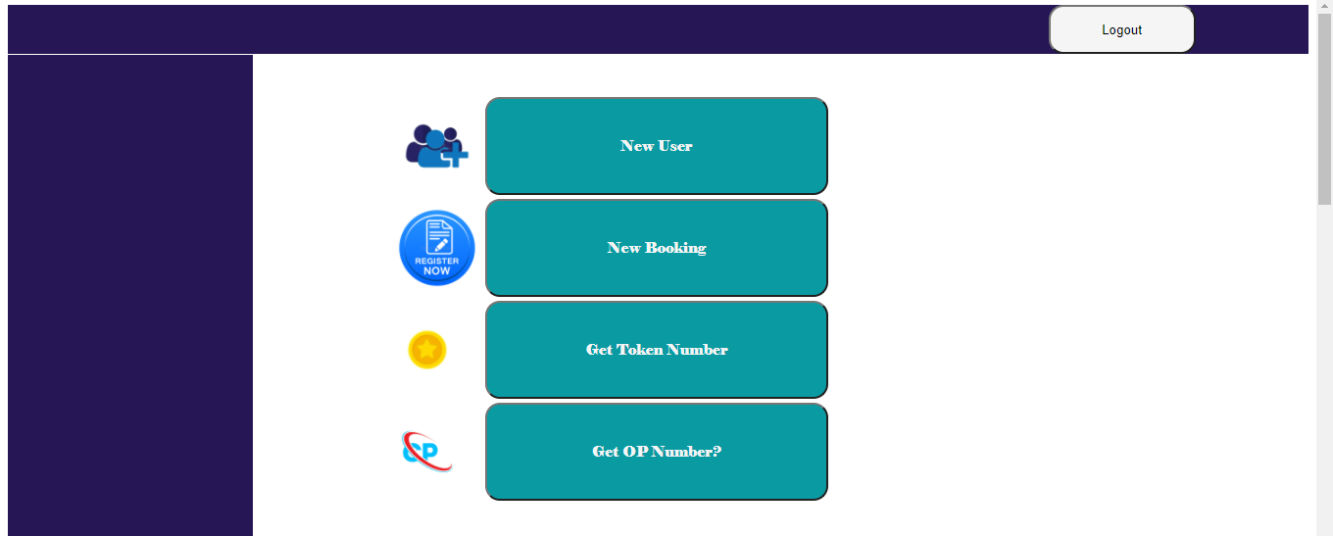
USERS – HOME PAGE

Slide 29
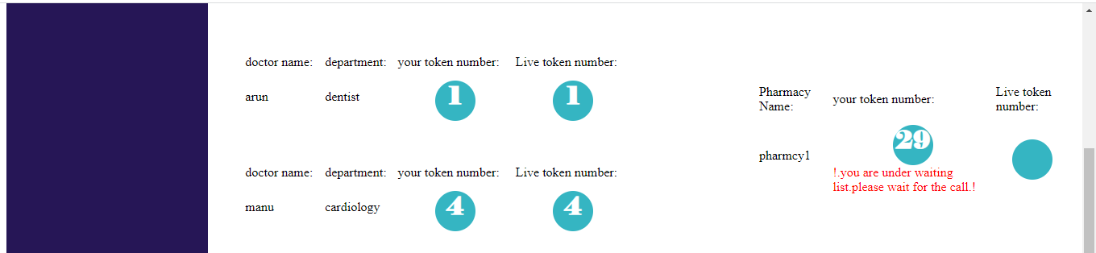
USERS – TOKEN PAGE

Slide 30
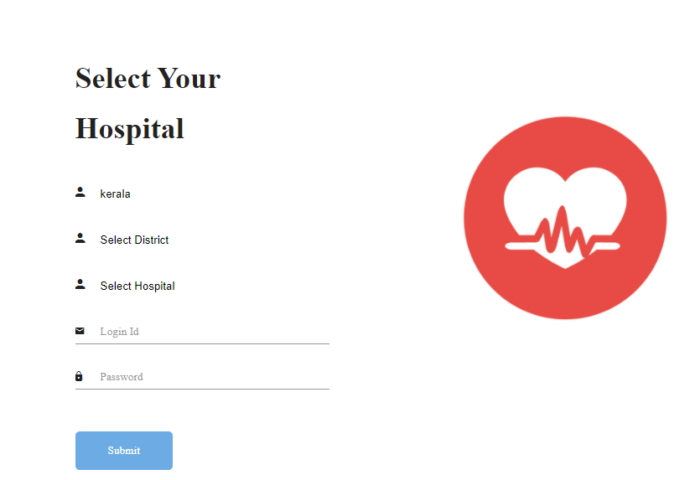
DOCTOR – LOGIN PAGE

Slide 31
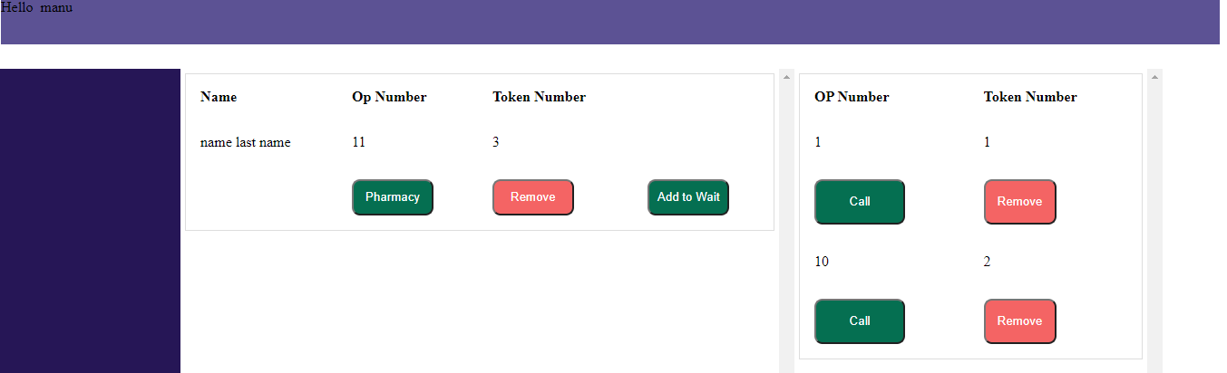
DOCTOR – CALLING/WAITLIST PAGE

Slide 32
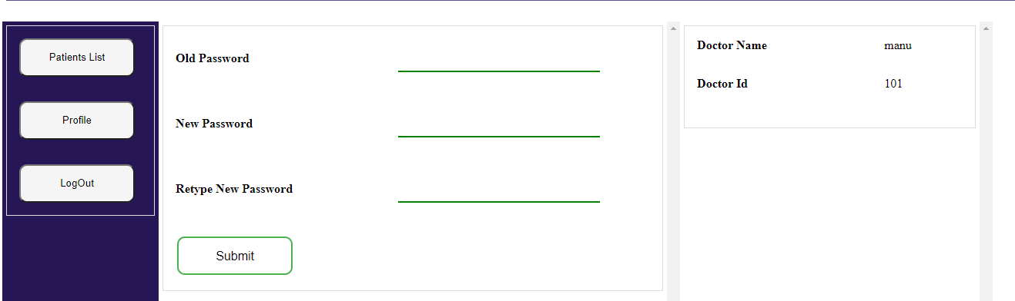
DOCTOR – PROFILE PAGE

